Slide 1
Lesson Plan
Lesson Overview
Objective(s) | Solve linear equations where the unknown is on both sides |  |  |  |  | Grade | 5
Prior Knowledge | Simple linear equations (the starter is a recap); substitution; fractions and negative numbers. Examples used in examination style questions include angles in polygons.
Duration | Total suggested duration is 60 minutes (may vary with ability and the amount of each task used).
Resources | Print slides: 19 - 25 |  |  | Equipment
Progression of Learning
What are the students learning? |  | How are the students learning? (Activities & Differentiation)
Solving linear equations with unknown on one side |  | PRINT slide 19. This task is intended to give students some initial confidence about solving equations, as well as leading into the task about establishing a method that can be adapted for more difficult equations. Check answers with students and then move to slide 5 which shows the first equation again, this time using a method that involves applying the method and being able to verify that it gives the correct solution by comparing with previous work. |  |  |  |  | 10
Solving linear equations where the unknown is on both sides |  | PRINT slide 20. Slide 6 uses the method introduced in slide 5 and applies it to an equation where the unknown is on both sides. Then demonstrate the application on this method to the 4 examples using slides 7 to 10. 4 practice slides follow. PRINT slides 21, 22, 23 and 24. Practice (1) keeps all coefficients positive. Practice (2) introduces some negative constants (but not coefficients of x) Practice (3) introduces negatives throughout. In all three practices, the first five answers are positive integers, followed by some with negative integers and, finally, answers best expressed as fractions. Practice (4) is mixed practice. |  |  |  |  | 10 30
Examination style questions |  | PRINT slide 25. These are examination style questions. Review solutions using slides 15 to 18. |  |  |  |  | 10
Next Steps | Solving quadratic equations | Assessment | PLC/Reformed Specification/Target 3/Algebra/Linear equations with unknown on both sides

Slide 2
Linear Equations
Optional: Calculators
NO whiteboards needed
PBiS focus: Respect
- Following instructions and listening.
Be able to:
Solve linear equations with one unknown on both sides and those involving brackets.
Plan:
Review 1 and 2 step equations
Pronumerals both sides
DPM/A

Slide 3
Formal method for solving (balancing method)
Let’s use the first of these equations to look at a methodical approach that will work when the going gets a little more tough…
6x + 5 = 17
It may seem obvious, but this means that what is in each of the two boxes are the same size.
Do the same operation to each side (each box) and they will still be the same size as each other when you are done.
−5
−5
6x = 12
÷6
÷6
x = 2

Slide 4
Starter – exercise books 5 mins
Use any method you like to find the value of x in each of these equations
x
1
6x + 5 = 17
x = 2
6
+ 5 = 13
x = 16
2
2
5x − 1 = 9
x = 2
x
3
7x + 5 = 40
x = 5
7
− 6 = 3
x = 27
3
4
3x − 2 = 10
x = 4
x
5
5x + 1 = 36
x = 7
8
+ 8 = 14
x = 30
5
Click an equation to see the solution, or
show all

Slide 5
Equations with unknowns on both sides
When the going gets tough, the tough get going…
Let’s use the first of these equations to look at a methodical approach that will work when the going gets a little more tough…
6x + 5 =
17
4x +
It may seem obvious, but this means that what is in each of the two boxes are the same size.
Do the same operation to each side (each box) and they will still be the same size as each other when you are done.
−5
−5
6x = 4x + 12
−4x
−4x
Now try this method on at least three of the equations you did a moment ago. Make sure you get the same solution.
2x = 12
÷2
÷2
x = 6

Slide 6
Example 1 – copy on sheet
2x + 12 = 7x + 2
- 2x
- 2x
12 = 5x + 2
- 2
- 2
10 = 5x
÷ 5
÷ 5
2 = x
Notes:
What you do to one side, you must do to the other. Read as red appears

Slide 7
Example 2 - copy on sheet
2) 7x + 8 = 9x
- 7x
- 7x
8 = 2x
÷ 2
÷ 2
4 = x

Slide 8
Choral response
The leading term multiplies to everything inside the brackets.
The ______ term multiplies to everything inside the brackets.
The ______ term multiplies to _________ inside the brackets.

Slide 9
Example 3 - copy on sheet
Leading term
Everything inside
4(y + 7) = 6y
4y
+ 28
= 6y
- 4y
- 4y
28 = 2y
÷ 2
÷ 2
14 = y

Slide 10
Example 4 - copy on sheet
Leading term
Everything inside
6(a + 2) = 4(a + 5)
6a + 12
= 4a + 20
- 4a
- 4a
2a + 12 = 20
- 12
- 12
2a = 8
÷ 2
÷ 2
a = 4

Slide 11
Practice (1)
When the going gets tough, the tough get going…
1
7x + 2 = 3x + 14
x = 3
6
7x + 15 = 3x + 7
x = −2
2
5x + 1 = x + 9
x = 2
7
5x + 17 = x + 5
x = −3
3
7x + 5 = 4x + 20
x = 5
8
5x + 7 = 2x + 13
x = 2
4
3x + 2 = x + 10
x = 4
9
7x + 1 = 4x + 21
x = 6
2
3
5
5x + 1 = 3x + 13
x = 6
10
x + 8 = 9x + 14
x = −
3
4
Show your working out!
Make your method clear, and remember that marks are still up for grabs if the answer is wrong!
Click an equation to see the solution, or
show all

Slide 12
Practice (2)
Now with added negative signs…
1
4x + 18 = 7x − 12
x = 10
6
4x + 13 = 6x + 19
x = −3
2
5x − 4 = 2x + 11
x = 5
7
5x − 3 = x − 15
x = −3
3
9x + 3 = 4x + 28
x = 5
8
6x + 7 = 8x − 4
1
2
x = 5
4
3x − 13 = 4x − 17
x = 4
9
7x − 1 = 4x − 11
x = −3
1
3
5
9x − 8 = x + 16
x = 3
10
11x + 4 = x − 2
x = −
3
5
A hint; it is usually easier to rearrange the equation so that x is on the side that already has more. Why is this?
Make sure you are careful about the negative signs here. Keep clear to which term a negative sign “belongs”.
Click an equation to see the solution, or
show all

Slide 13
Practice (3)
Here the negative signs may be on the x term itself…
1
4x − 11 = 10 − 7x
x = 3
6
4x = 6x + 10
x = −5
2
5x − 6 = 2x
x = 2
7
3 − 2x = x + 6
x = −1
3
9x = 4x + 30
x = 6
8
6x + 7 = 8x
1
2
x = 3
4
3x − 7 = 17 − 5x
x = 3
9
1 − x = x + 4
x = −1
1
2
5
7 − 3x = 2x − 13
x = 4
10
5 − 3x = 3x
x = −
5
6
A hint; it is usually easier to rearrange the equation so that x is on the side that already has more. Why is this?
Show your working out!
Make your method clear, and remember that marks are still up for grabs if the answer is wrong!
Make sure you are careful about the negative signs here. Keep clear to which term a negative sign “belongs”.
Click an equation to see the solution, or
show all

Slide 14
Mixed practice
2x + 10 = 7x + 5
3x + 9 = 6x
3 (x + 4) = 6x
8y - 6 = 2(y + 9)
3(a + 4) = 5 (a + 2)
3x - 8 = x + 2
2x + 12 = 6x
5 + 3x = 9x – 4
2 (a + 5) = 6 ( a – 5)
5 (y – 6) = 2 ( 6 + y)
4b = 6b - 12
x = 1
x = 3
x = 4
y = 4
a = 1
x = 5
x = 3
x = 1.5
a = 10
y = 14
b = 6

Slide 15
Problem solving and reasoning
ABCD is a parallelogram.
Find the size of angle y°.
Here is part of a drawing of a regular polygon.
It shows two of the interior angles of the regular polygon.
How many sides does the regular polygon have?
C
D
y°
(5x − 10)°
(6x − 70)°
(4x + 10)°
(3x + 50)°
y°
B
A
6x − 70 = 4x + 10
6x − 4x = 10 + 70
2x = 80
x = 80 ÷ 2
x = 40
Each angle is 170°, if x = 40;
Exterior angles give
360 ÷ (180 − 170) = 36 sides.
5x − 10 = 3x + 50
5x − 3x = 50 + 10
2x = 60
x = 60 ÷ 2
x = 30
5x − 10 = 3x + 50
= 140 when x = 30
y = (360 − 140 − 140) ÷ 2
y = 40

Slide 16
Problem solving and reasoning
A
ABC is an isosceles triangle.
Find the value of a.
Find the length AB.
2a + 6
5a - 3
a)
2a + 6 =
5a - 3
- 2a
- 2a
6 = 3a - 3
+ 3
+ 3
C
B
9 = 3a
÷ 3
÷ 3
3 = a

Slide 17
Problem solving and reasoning
A
ABC is an isosceles triangle.
Find the value of a.
Find the length AB.
2a + 6
5a - 3
b)
AB = 2a + 6
a = 3
AB = 2x3 + 6
B
C
AB = 6 + 6
AB = 12 units

Slide 18
Problem solving and reasoning
Carl thinks of a number. He multiplies this by 3 then adds 23.
Liz thinks of a number and she adds 3, then she multiplies this by 5.
The number they chose and sums at the end are equal. What is the number they have picked?
They think of the same number to start with, lets say x.
Carl’s expression => 3x + 23
Liz’s expression => 5(x + 3)
3x + 23 = 5(x + 3)
3x + 23 = 5x + 15
23 = 2x + 15
8 = 2x
4 = x They thought of number 4.

Slide 19
Starter
Use any method you like to find the value of x in each of these equations
x
1
6x + 5 = 17
6
+ 5 = 13
2
2
5x − 1 = 9
x
3
7x + 5 = 40
7
− 6 = 3
3
4
3x − 2 = 10
x
5
5x + 1 = 36
8
+ 8 = 14
5
Student Sheet 1

Slide 20
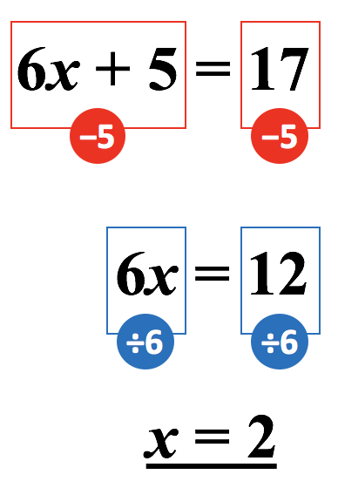
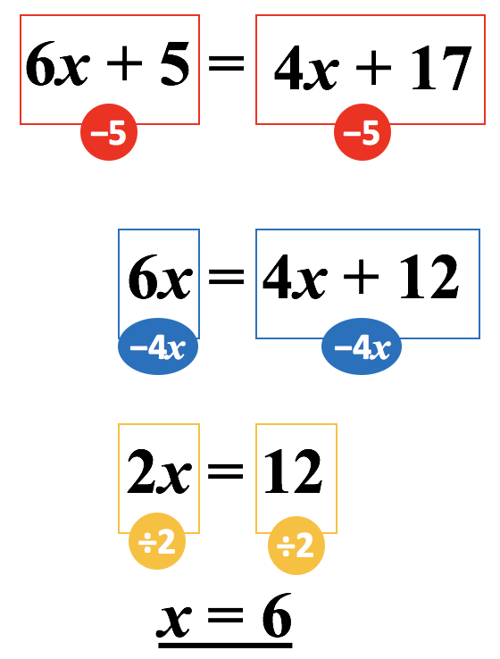
Formal method for solving
2x + 12 = 7x + 2
2) 7x + 8 = 9x
4 (y + 7) = 6y
6 (a + 2) = 4 (a + 5)
Student Sheet 2

Slide 21
Practice (1)
When the going gets tough, the tough get going…
1
7x + 2 = 3x + 14
6
7x + 15 = 3x + 7
2
5x + 1 = x + 9
7
5x + 17 = x + 5
3
7x + 5 = 4x + 20
8
5x + 7 = 2x + 13
4
3x + 2 = x + 10
9
7x + 1 = 4x + 21
5
5x + 1 = 3x + 13
10
x + 8 = 9x + 14
Student Sheet 3

Slide 22
Practice (2)
Now with added negative signs…
1
4x + 18 = 7x − 12
6
4x + 13 = 6x + 19
2
5x − 4 = 2x + 11
7
5x − 3 = x − 15
3
9x + 3 = 4x + 28
8
6x + 7 = 8x − 4
4
3x − 13 = 4x − 17
9
7x − 1 = 4x − 11
5
9x − 8 = x + 16
10
11x + 4 = x − 2
A hint; it is usually easier to rearrange the equation so that x is on the side that already has more. Why is this?
Make sure you are careful about the negative signs here. Keep clear to which term a negative sign “belongs”.
Student Sheet 4

Slide 23
Practice (3)
Here the negative signs may be on the x term itself…
1
4x − 11 = 10 − 7x
6
4x = 6x + 10
2
5x − 6 = 2x
7
3 − 2x = x + 6
3
9x = 4x + 30
8
6x + 7 = 8x
4
3x − 7 = 17 − 5x
9
1 − x = x + 4
5
7 − 3x = 2x − 13
10
5 − 3x = 3x
A hint; it is usually easier to rearrange the equation so that x is on the side that already has more. Why is this?
Make sure you are careful about the negative signs here. Keep clear to which term a negative sign “belongs”.
Student Sheet 5

Slide 24
Mixed practice
3x - 8 = x + 2
2x + 12 = 6x
5 + 3x = 9x – 4
2 (a + 5) = 6 ( a – 5)
5 (y – 6) = 2 ( 6 + y)
4b = 6b - 12
2x + 10 = 7x + 5
3x + 9 = 6x
3 (x + 4) = 6x
8y - 6 = 2(y + 9)
3(a + 4) = 5 (a + 2)
Student Sheet 6

Slide 25
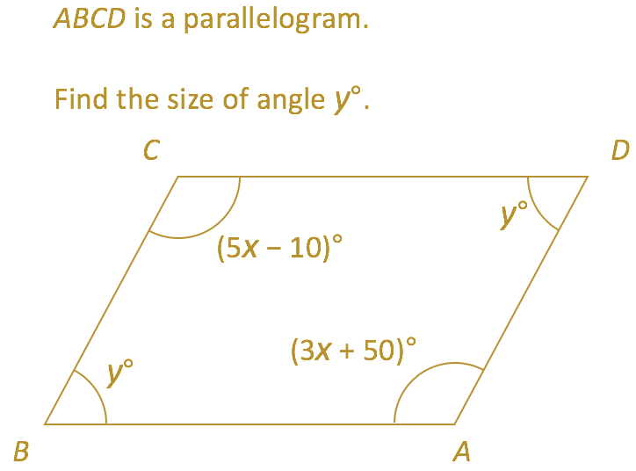
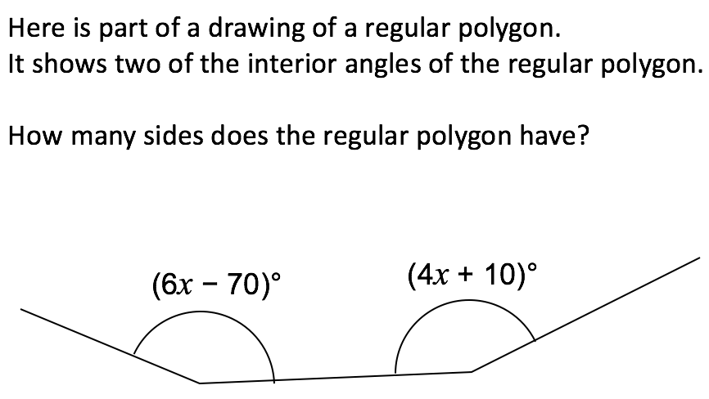
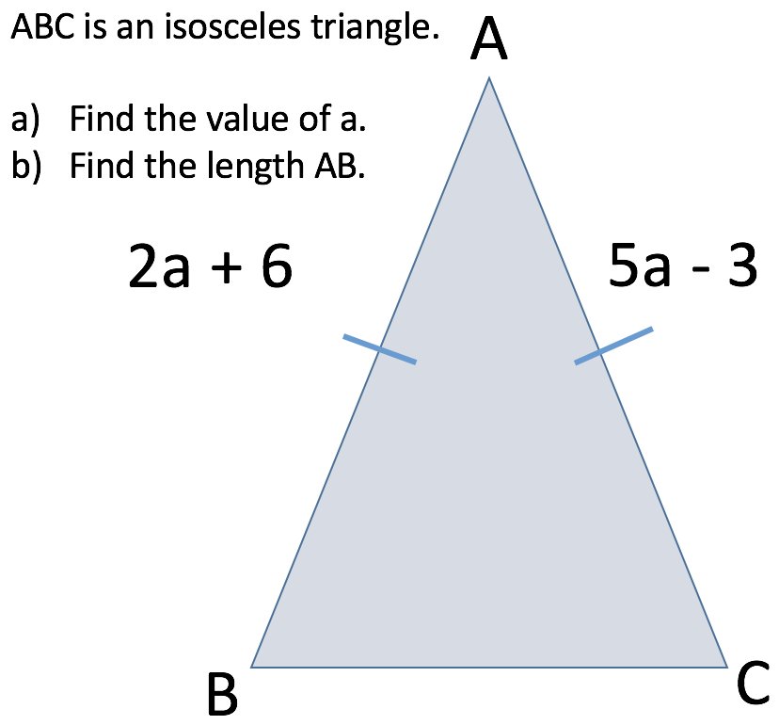
Problem solving and reasoning
Carl thinks of a number. He multiplies this by 3 then adds 23. Liz thinks of a number and she adds 3, then she multiplies this by 5. The number they chose and sums at the end are equal. What is the number they have picked?
Student Sheet 7

